Slide 1

Input output
Er. Deeyoranjan Dongol

Slide 2
I/O MANAGEMENT
All computers have physical devices for acquiring input and producing output
OS is responsible to manage and control all I/O operations and I/O devices
Some principles I/O hardware
I/O Devices
I/O Controllers
Memory mapped I/O
DMA
I/O Handling

Slide 3
I/O DEVICES
A I/O units which consists of mechanical components are called I/O devices such as hard-disk drive, mouse
There are two types of devices
Block Devices [Disk]
Stores information in fixed sized blocks
Each one with its own address
Read/Write is possible independently
Character Devices [Printer]
Delivers or accepts a stream of characters without regard to any block structure
Not addressable

Slide 4
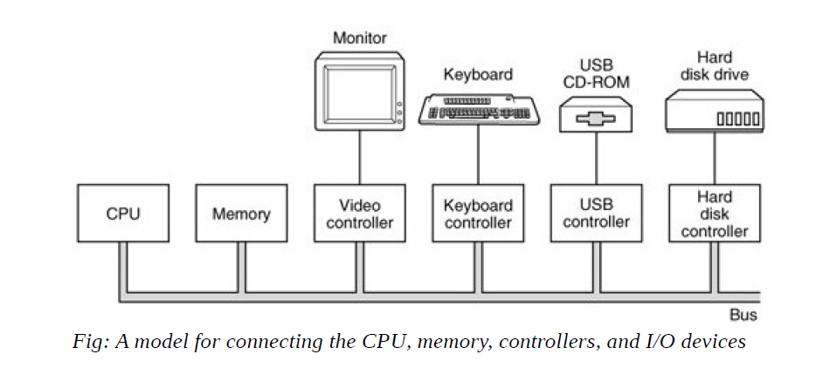
DEVICE CONTROLLERS
A controller is a collection of electronic component that can operate a bus or a device
A single controller can handle multiple devices but some devices have their own built-in controller
The controller has one or more registers for data and signals; processor communicates with controller by reading and writing bit patterns in these registers

Slide 5
MEMORY-MAPPED I/O
The device control registers are mapped into memory space called memory-mapped I/O
Usually the assigned addresses are at the top of the address space

Slide 6
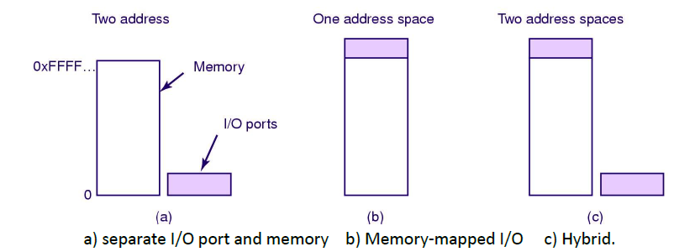
MEMORY-MAPPED I/O
When a CPU wants to read a word either from memory or from I/O port, it puts the address it needs on the bus’s address line and then asserts the read signals on bus’s control line
A second signal is used to tell whether I/O or memory space is needed

Slide 7
I/O HANDLING
Programmed I/O (Polling)
Processing is interrupted at brief intervals to allow the CPU to check back to I/O to see if the I/O operations has completed
Used in embedded system
Interrupt-Driven I/O
The hardware mechanism that enables a device to notify the CPU
Interrupt forces to stop CPU what it is doing and start doing something else
I/O Using DMA

Slide 8
I/O HANDLING
Scenario: a cook is cooking something in modern microwave oven equipped kitchen
CASE A: The cook may regularly peek through the oven’s glass door and watch as roast cooks under cook and watch; this kind of monitoring is polling
CASE B: The cook may set a timer to expire after as appropriate number of minutes; the buzzer sounding after this interval is an interrupt

Slide 9
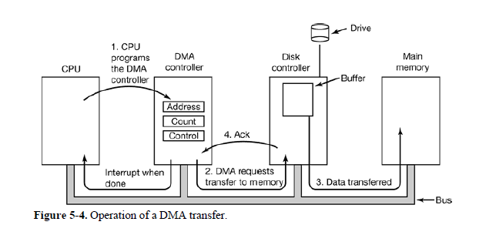
DIRECT MEMORY ACCESS [DMA]

Slide 10
DIRECT MEMORY ACCESS[DMA] WORKS
The CPU programs the DMA controller by its register so it knows what to transfer where. It also issues a command to disk controller telling it to read data from disk to its internal buffer and verify the checksum. When valid data are in disk’s controller buffer, DMA can begin
The DMA controller initiates the transfer by issuing a read request over the bus to disk controller
Data transferred from disk controller to memory
When transferred completed, the disk controller sends an acknowledgement signal to DMA controller. The DMA controller then increments the memory address and decrements the byte count. This continues until byte count reaches 0
When transfer completed the DMA controller interrupt the CPU

Slide 11
I/O SOFTWARE ISSUES (GOALS OF I/O SOFTWARE)
Device Independence
Uniform Naming
Error Handling
Synchronous Vs Asynchronous transfer
Buffering

Slide 12
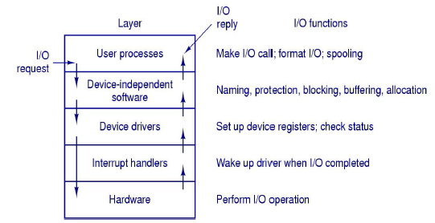
I/O SOFTWARE LAYERS

Slide 13
I/O SOFTWARE LAYERRS
Interrupt Handlers
Block the driver until the I/O has completed and the interrupt occur
The interrupt handler determines the cause of the interrupt and performs the necessary processing
Save any registers that have not already been saved by the interrupt hardware
Set up stack for interrupt service procedure
Ack interrupt controller
Copy registers from where they were saved to the process table
Run the interrupt service procedure
Set up the MMU context for the process to run next
Load new process’s registers
Start running the new process

Slide 14
I/O SOFTWARE LAYERRS
Device Drivers
Each I/O device attached to a computer needs some device-specific code for controlling it called device driver
Generally written by device manufacturer and delivered along with the device
Each device driver normally handles one device type or at most one class of closely related devices
Functions:
Accept read write requests from the device independent software above it
Manage power requirement and log events
Checks the status of devices in use or free

Slide 15
I/O SOFTWARE LAYERRS
Device Independent OS software
The devices independent software is to perform the I/O functions that are common to all devices and to provide a uniform interface to the user-level software
Functions:
Uniform interfacing for devices
Buffering
Error reporting
Allocating and releasing dedicated devices
Providing a device independent block size

Slide 16
I/O SOFTWARE LAYERRS
User Processes
System calls including the I/O system calls are normally made by the user processes
User processes put their parameters in the appropriate place for the system calls or other procedures that actually do real work

Slide 17
DISKS

Slide 18
Disks come in many sizes and speeds and information may be stored optically or magnetically
Example:- floppy disks, hard disks, CD-ROMS and DVDS
Disk surface is divided into number of logical block called sectors and tracks
The term cylinder refers to all the tracks at particular head position in hard disk

Slide 19
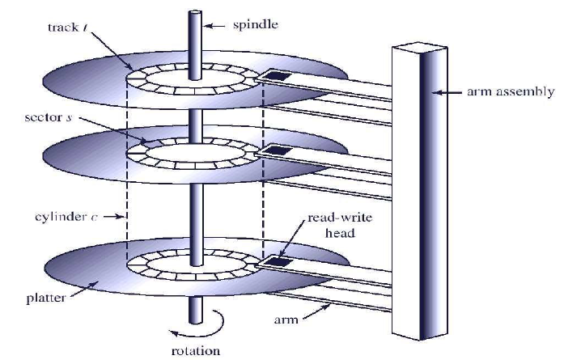
Disk Structure

Slide 20
Latency Time
Time taken to rotate from its current position to a position adjacent to the read-write head
Seek
The processes of moving the arm assembly to new cylinder
To access a particular record, first the arm assembly must be moved to the appropriate cylinder and then rotate the disk until it is immediately under the read-write head.
The time to access the whole record is called transmission time

Slide 21
OS is responsible to use the hardware efficiently i.e. fast seek, latency and transmission time
For most disks, the seek time dominates the other two, so reducing the mean seek time can improve system performance
Consider a disk queue with requests for I/O to blocks on cylinders 98, 183, 41, 122, 14, 124, 65, 67. The head is initially at cylinder number 53 moving towards larger cylinder numbers on its servicing pass. The cylinders are numbered from 0 to 199. Calculate the total head movement for FCFS, SSTF, SCAN,C-SCAN, LOOK and C-LOOK Disk scheduling algorithm.

Slide 22
DISK SCHEDULING
First-Come-First-Serve(FCFS)
The first request to arrive is the first one serviced
Advantage: Simple and easy to implement
Problem: Does not provide fast service

Slide 23
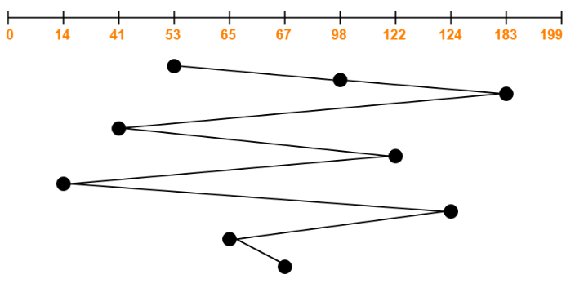
DISK SCHEDULING
First-Come-First-Serve(FCFS)
Total head movement = 632 cylinders

Slide 24
DISK SCHEDULING
Shortest-Seek-Time-First(SSTF)
Selects the request with the minimum seek time from the current head position
Advantage: Improved Performance
Problem: SSTF is a form of SJf scheduling and may cause starvation of some requests

Slide 25
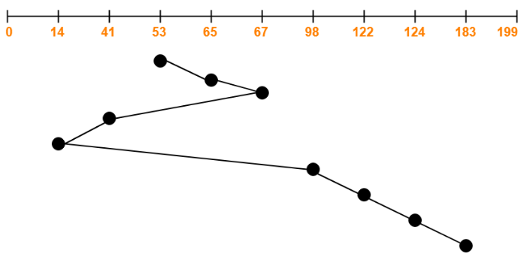
DISK SCHEDULING
Shortest-Seek-Time-First(SSTF)
Total head movement = 236 cylinders

Slide 26
DISK SCHEDULING
SCAN
The disk arm starts at one end of the disk and moves toward the other end, servicing requests until it gets to the other end of the disk, where head movement is reversed and servicing continues
Sometimes called elevator algorithm
Advantage: Decreases variances in seek and improve response time
Problem: Starvation possible if there are repeated request in current track

Slide 27
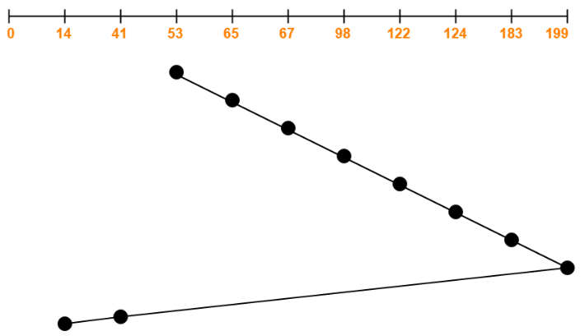
DISK SCHEDULING
SCAN
Total head movement = 331 cylinders

Slide 28
DISK SCHEDULING
C-SCAN
The head moves from one end of the disk to the other servicing requests as it goes. When it reaches the other end, however, it immediately returns to the beginning of the disk, without servicing any requests on the return trip

Slide 29
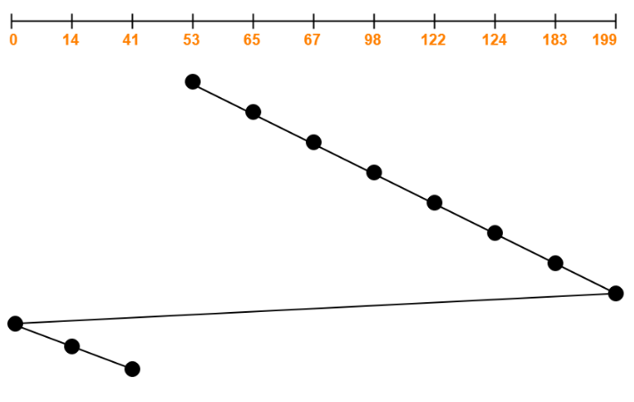
DISK SCHEDULING
C-SCAN
Total head movement = 386 cylinders

Slide 30
DISK SCHEDULING
LOOK
Head starts from the first request at one end of the disk and moves towards the last request at the other end servicing all the requests in between
After reaching the last request at the other end, head reverses its direction
Returns to the first request at the starting end servicing all the requests in between

Slide 31
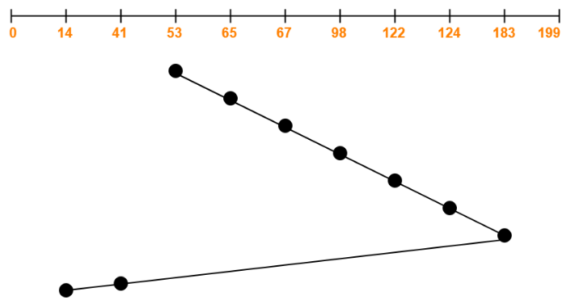
DISK SCHEDULING
LOOK
Total head movement = 299 cylinders

Slide 32
DISK SCHEDULING
C-LOOK
Head starts from the first request at one end of the disk and moves towards the last request at the other end servicing all the requests in between
After reaching the last request at the other end, head reverses its direction
Returns to the first request at the starting end without servicing any requests in between

Slide 33
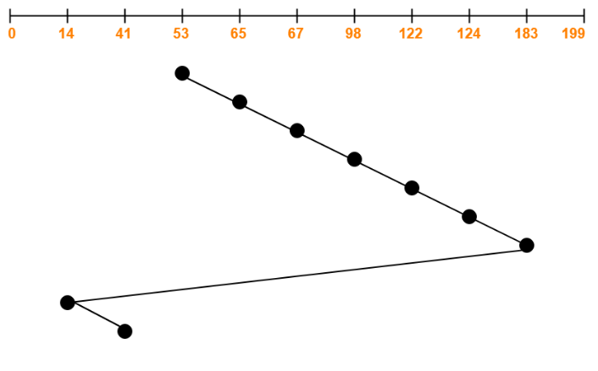
DISK SCHEDULING
C-LOOK
Total head movement = 326 cylinders

Slide 34

DISK FORMATTING
Disk Formatting
Before a disk can store data, it must be divided into sectors that the disk controller can read and write called low-level formatting
The sector typically consists of
Preamble:- Contains cylinder and sector number
ECC:- Contains redundant information that can be used to recover from read error

Slide 35
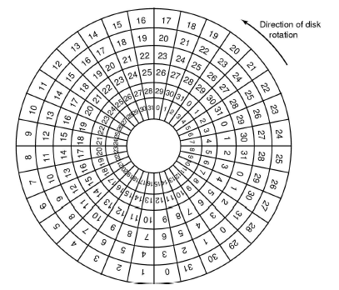
DISK FORMATTING

Slide 36
DISK FORMATTING
If disk I/O operations are limited to transferring a single sector at a time, it reads the first sector from the disk and doing ECC calculation transfers data to main memory, during this time the next sector will fly by the head
When transferring completes the controller will have to wait almost an entire rotation for the second sector to come around again
This problem can be eliminated by numbering the sectors in an interleaved fashion when formatting the disk
According to copying rate, interleaving may be of single or double

Slide 37
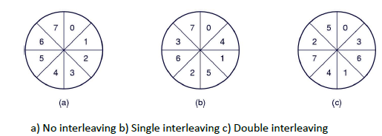
DISK FORMATTING

Slide 38
ERROR HANDLING
Most frequently, one or more sectors becomes defective or most disks even come from factory with bad blocks
Depending on the disk and controller in use, these blocks are handled in variety of ways
Bad blocks are handled manually
Run MS-DOS chkdsk – find bad block
Format command to create new block
Using bad block recovery
Controller maintains the list of bad blocks on the disk and substituted with spare

Slide 39
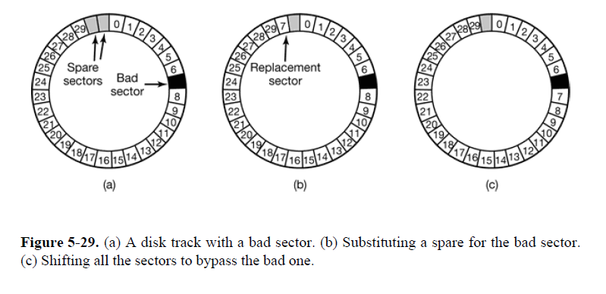
ERROR HANDLING

Slide 40
RAID (Redundant Array of Inexpensive Disks)
Issues: Disk Performance, Amount of Storage required and Reliability
A technique of organizing multiple disks to address above issues is RAID
RAID allows more than one disk to be used for a given operation and allows continued operation and even automatic recovery in the face of disk failure
There are six types of organization called RAID levels

Slide 41
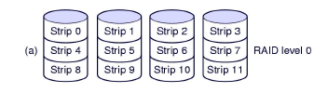
RAID LEVELS
RAID Level 0
Creates one large virtual disk from a number of smaller disks
Storage is grouped into logical units called strips
Virtual storage is sequence of strips interleaved among the disks in the array
Advantage
Can create large disk
Performance benefit can be achieved
Disadvantage
Reliability decrease

Slide 42
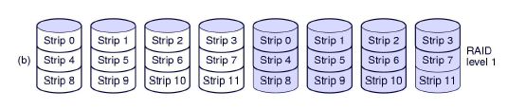
RAID LEVELS
RAID Level 1
Stores duplicate copy of each strip with each copy on a different disk
Advantage
Excellent reliability; if drive crashes the copy is used
Read performance can be achieved
Disadvantage
Write performance is no better than in single drive

Slide 43
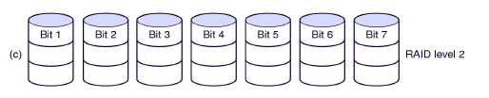
RAID LEVELS
RAID Level 2
An error-correcting code is used for corresponding bits on each data disks
Error-correcting code scheme stores two or more extra bits and can reconstruct the data if a single bit get damaged
Advantage
Total parallelism
Disadvantage
Requires substantial number of drives
Notes:
For Example, the first bit of each byte is stored in disk 1, second bit in disk 2, and until eight bit in disk 8, and error correcting bits are stored in further disks. If one of the disk fail, the remaining bits of the byte and associated error-correction bits can be read from other disks and be used to reconstruct the damage data.

Slide 44

RAID LEVELS
RAID Level 3
Simplified version of level 2
A single parity bit is used instead of error-correcting code, hence requires just one extra disk
If any disk in array fails, its data can be determined from the data on the remaining disks
It is as good as level 2 but is less expensive in the number of extra disks

Slide 45

RAID LEVELS
RAID Level 4
It uses block-level striping as in level 0, and in addition keeps a parity block on separate disk for corresponding blocks from other disks
If one of the disks fails, the parity block can be used with the corresponding blocks from other disks to restore the blocks of the fail disks
To compute parity, simple function XOR is used For a given set of bits, the XOR of all of those bits returns a 0 if there are an even number of 1’s in the bits, and a 1 if there are an odd number of 1’s
Problem: performance bottleneck

Slide 46
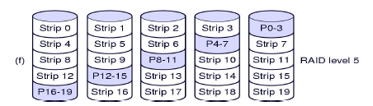
RAID LEVELS
RAID Level 5
Similar to level 4 but parity information is distributed in all disks
For each block one of the disk stores parity and other stores data

Slide 47
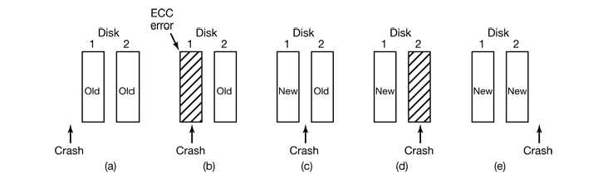
STABLE STORAGE
Major functions
Stable Writes
Stable Read
Crash Recovery
Notes:
In Fig. 5-30(a), the CPU crash happens before either copy of the block is written. During
recovery, neither will be changed and the old value will continue to exist, which is allowed.
In Fig. 5-30(b), the CPU crashes during the write to drive l, destroying the contents of the
block. However the recovery program detects this error and restores the block on drive 1
from drive 2. Thus the effect of the crash is wiped out and the old state is fully restored.
In Fig. 5-30(c), the CPU crash happens after drive 1 is written but before drive 2 is written.
The point of no return has been passed here: the recovery program copies the block from
drive 1 to drive 2. The write succeeds.
Fig. 5-30(d) is like Fig. 5-30(b): during recovery, the good block overwrites the bad block.
Again, the final value of both blocks is the new one.
Finally, in Fig. 5-30(e) the recovery program sees that both blocks are the same, so neither
is changed and the write succeeds here too.

Slide 48
If 10,000 rpm disk has 300 sectors per track of 512 bytes each and calculate the data rate?
512*300 = 153600 bytes on a track
Data rate = 153600*10000/60 = 25600000 bytes/sec
= 24.4 MB/sec

Slide 49
A disk has 8 sectors per track and spins at 600 rpm. It takes the controller time 10ms from the end of one I/O operation before it can issue a subsequent one. How long does it take to read all 8 sectors using the following interleaving system?
a) No interleaving
b) Single interleaving
c) Double interleaving
http://www.urch.com/forums/gre-computer-science/6451-schaums-os-7-a.html
Notes:
60 secs ---- 600 rev
1 sec ---- 600/60 rev
1 sec ---- 10 rev
600 rev == 60 sec
1 rev == 60/600 sec
1 rev == (60/600)*1000 ms = 100 ms

Slide 50
Suppose that a disk drive has 300 cylinders, numbered from 0 to 299. The drive is currently serving a request at cylinder 143 and the previous request was at cylinder 15. The queue of pending requests, in FIFO order, is 86, 147, 291, 18, 95, 151, 12, 175, 30. Starting from the current head position, what is the total distance(in cylinders) that the disk arm moves to satisfy all the pending requests for each of the following disk- scheduling algorithms?
FCFS ii) SSTF iii) SCAN iv) C-SCAN
v) LOOK vi) C-LOOK
Notes:
60 secs ---- 600 rev
1 sec ---- 600/60 rev
1 sec ---- 10 rev
600 rev == 60 sec
1 rev == 60/600 sec
1 rev == (60/600)*1000 ms = 100 ms

Slide 51
CLOCKS & TERMINALS

Slide 52
Two types of clock
Simple clock: tied to 110 or 220 volt power line, causes an interrupt at every voltage cycle (50 or 60 Hz)
Other type, used in modern computers based on crystal oscillator
High accuracy, in the range of several hundred megahertz
A programmable clock

Slide 53
Programmable clocks
Two modes: one-shot vs. square-wave
In one-shot mode, when the clock is started, it copies the value of the holding register into the counter and then decrements the counter at each pulse from the crystal. When the counter gets to zero, it causes an interrupt and stops until it is explicitly started again by the software
In square-wave mode, after getting to zero and causing the interrupt, the holding register is automatically copied into the counter, and the whole process is repeated again indefinitely
Periodic interrupts are called “clock ticks”

Slide 54
Common duties of clock software
Maintaining the time of day
Preventing processes from running longer than they are allowed to
Accounting for CPU usage
Handling the alarm system call made by user processes
Providing watch-dog timers for parts of the system itself
Doing profiling, monitoring and statistics gathering
Soft Timers
Second programmable clock that can be set to cause timer interrupts at whatever rate a program needs

Slide 55
Terminals
A terminal is a device or a program that allows you to communicate with a computer system
Can be a physical device, such as a keyboard and a monitor, or a software application, such as a terminal emulator

